Slide 1

https://gateway.procurement.ucsb.edu
Materials Department, UCSB
Notes:
ok

Slide 2
Shopping
Notes:
ok

Slide 3
How do I get access?
Everybody that has a UCSB Net ID already has access to Gateway.
Be sure to turn off your cookies and your pop-up blocker.
Notes:
ok

Slide 4
Notes:
ok

Slide 5
Low Value/High Value Orders
Purchases will no longer be classified as low value and high value.
  For orders being purchased using federal funds (contracts, grants), you will still need to complete a Sole Source for orders $3,000 or more, and a professional buyer will review and approve the transaction.
  For orders being purchased using non-federal funds, a professional buyer will not need to review the order unless it is $10,000 or more (unless it’s a restricted commodity).
Notes:
ok

Slide 6
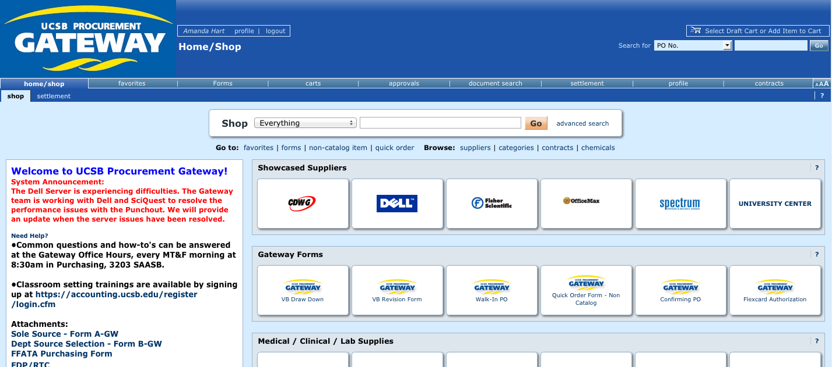
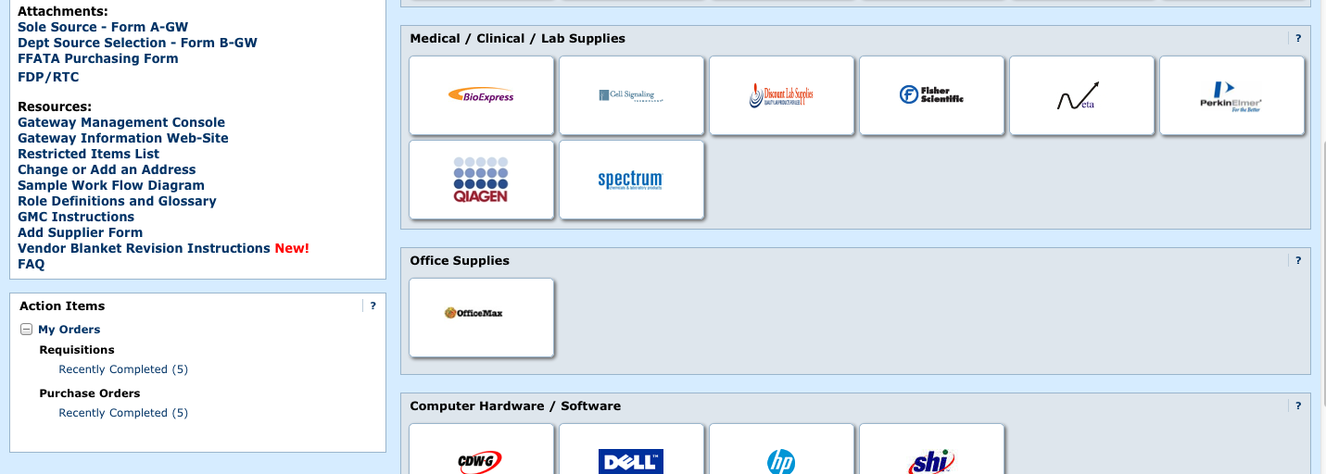
Notes:
ok

Slide 7
How to Initiate a Purchase
Punch-out Suppliers
  You can create a cart directly on the vendor’s website, and the check-out process takes you back to the Gateway portal for completion.
Catalog Suppliers
  You can browse the vendor’s catalog and create your cart without ever leaving the Gateway portal.
Non-catalog Suppliers
  You need to manually enter the catalog number, item description, cost, quantity, etc.
Notes:
ok

Slide 8
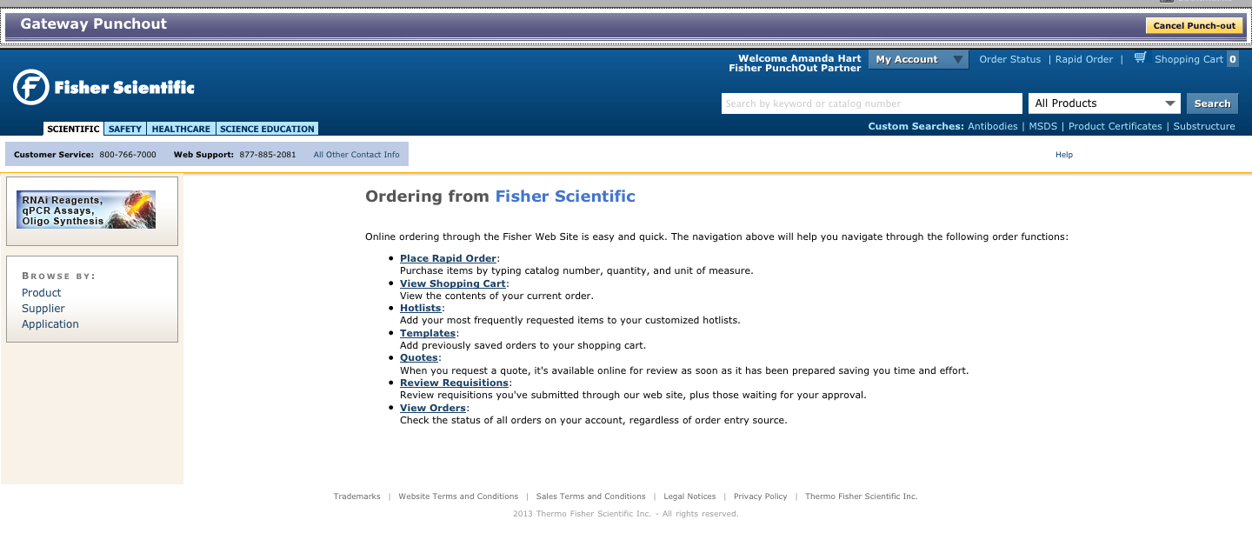
Punch-Out Suppliers
Notes:
ok

Slide 9
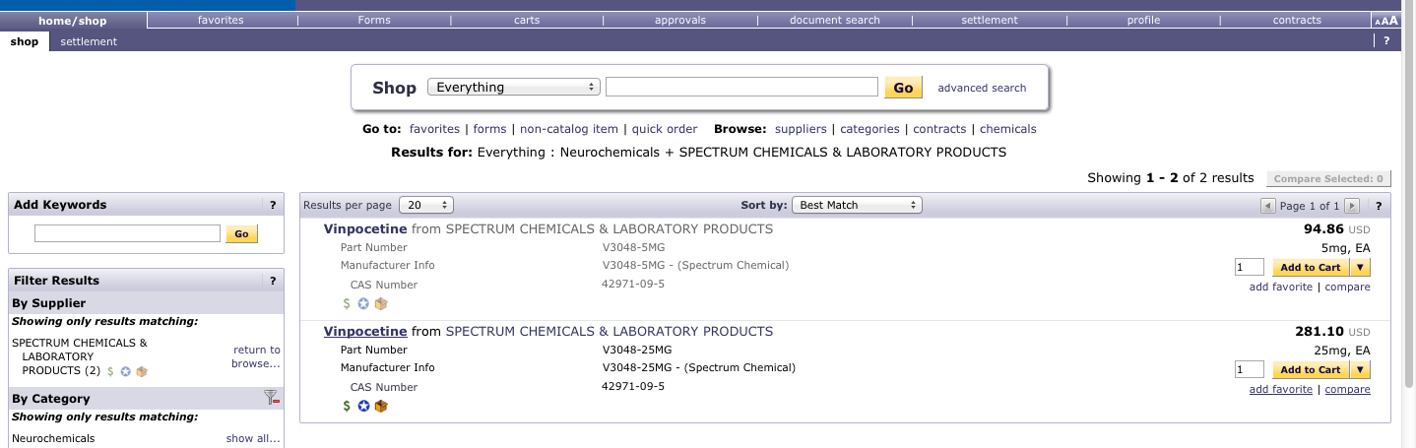
Catalog Suppliers
Notes:
ok

Slide 10
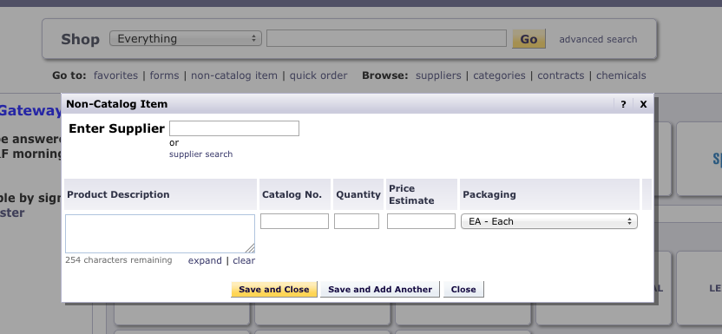
Non-Catalog Suppliers
Notes:
ok

Slide 11
Your Shopping Cart
And order finalization.
Notes:
ok

Slide 12
What type of shopper are you?
Based on your advisor’s preferences, you are either:
  a shopper who assigns your cart directly to your advisor for approval
  a shopper who has limited self-approving permission (up to $500)
  a non-student senior group member who has higher level approval permission.
If you have questions about what type of shopper you are, please see your advisor.
Notes:
ok

Slide 13
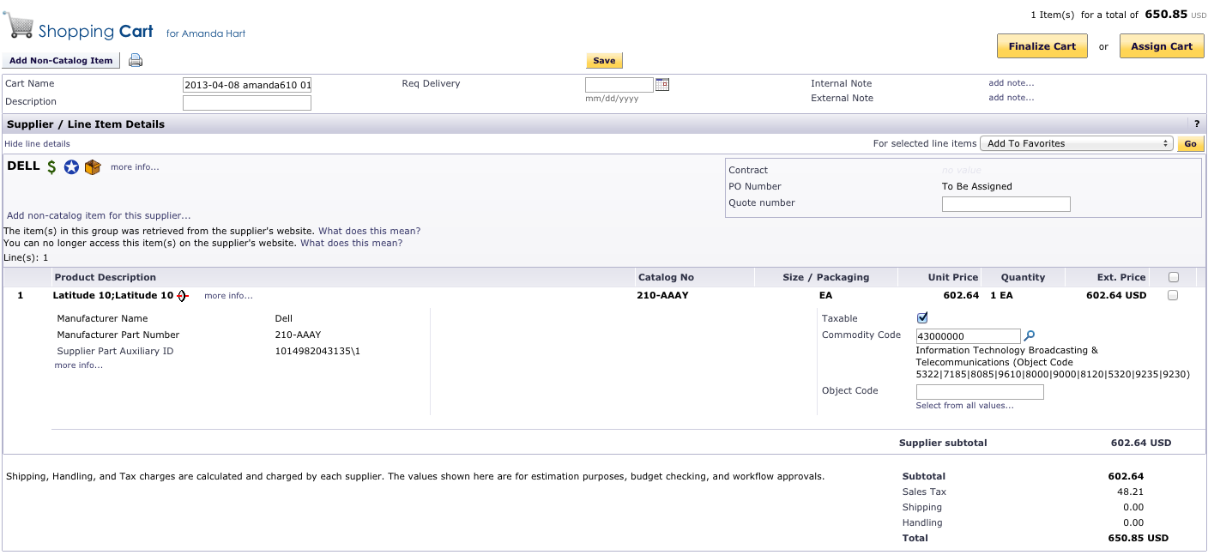
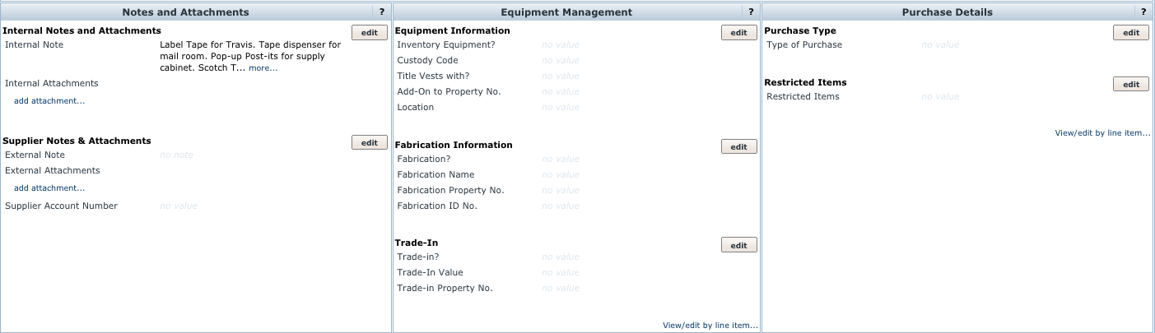
Notes:
ok

Slide 14
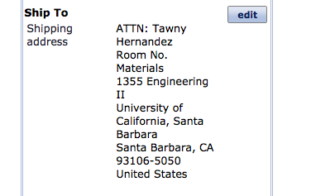
Shipping Address
Gateway will prompt you to enter a shipping address. Enter ENMT in the search field.
You can add your own name in the ATTN field. DO NOT enter a room number.
Notes:
ok

Slide 15
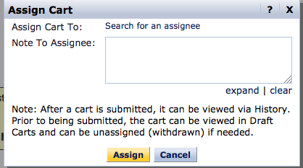
Assigning your Cart
If you are not a self-approving shopper or your order is over $500, you must assign your cart to your advisor or their designee.

Slide 16
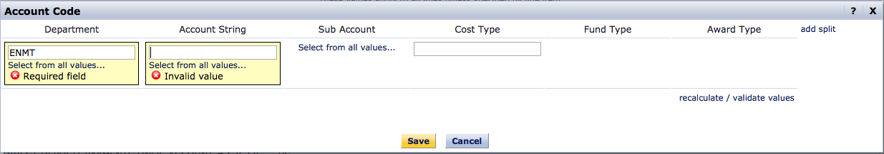
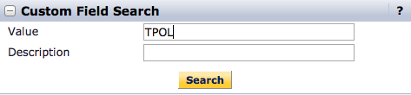
Finalizing your Cart
If you are a self-approving shopper, you need to finalize your cart by adding the appropriate account:
Notes:
ok

Slide 17
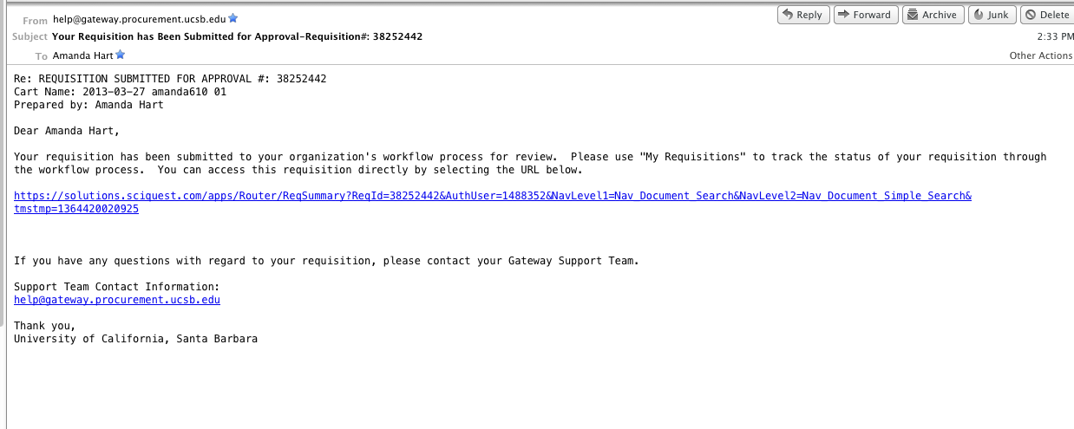
Requisition Submission
When your requisition has been submitted for approval, you will receive an email that looks like this:
Notes:
ok

Slide 18
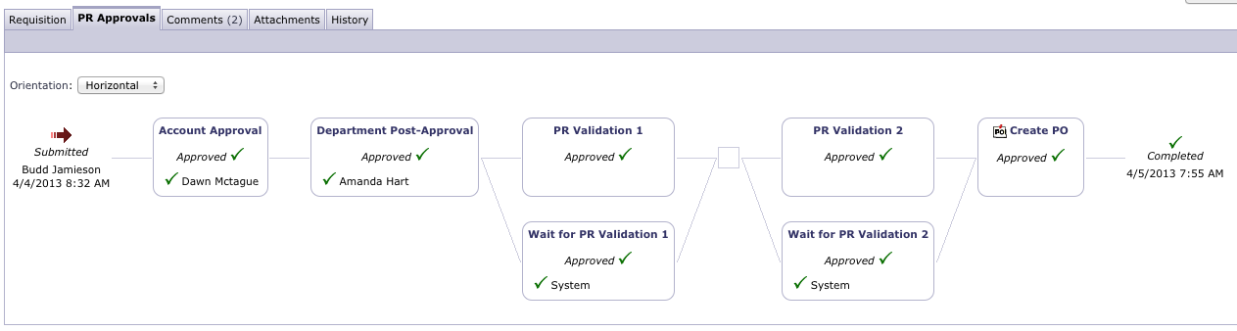
How to check on your order:
Notes:
ok

Slide 19
Frequently Asked Questions
My order has been completed…what do I do next?
  Nothing! The vendor will automatically receive the purchase order via fax or email.
Do I still need to turn in my packing slips?
  Yes! The supplier will not be paid unless the Department Buyer (Amanda) marks each line item as “received” in Gateway. We will not know to do that unless you turn in your packing slip.
What if I need to use a supplier that is not in Gateway?
  Use the “Add Supplier Form” on the Gateway homepage. It generally takes 1 to 5 business days for the supplier to be added. If the order is urgent, please come to the Purchasing office and we may be able to place your order with the department FlexCard.
Notes:
ok

Slide 20
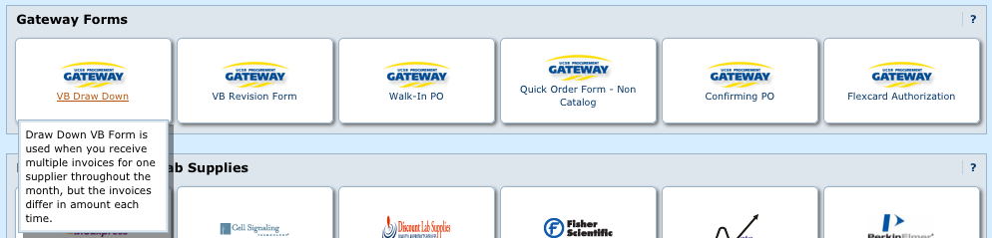
FAQ’s Continued
Can I still get an on-going PO (AKA vendor blanket)?
  Yes, on the home page we can place orders for either recurring services or items. Please come to the Purchasing Office for assistance setting these up.
Notes:
ok

Slide 21
Approving

Slide 22
Who is an Approver?
You are an Approver if:
  You are the P.I. and therefore have blanket authority to approve all transactions at any dollar level on your funds.
  The P.I. has given you authority to make purchases up to a certain dollar amount (usually $500) on one or more of his/her accounts.
Notes:
ok

Slide 23
Managing Approvals
In many cases, more than one Approver will be set up on a funding source. Therefore, when a requisition is ready to be approved, each Approver will be notified.
So, whose job is it to approve the order? Each P.I. needs to make it clear to his/her group what the procedure should be.
  Some P.I.’s wish to be involved on every purchase and will be the sole Approver.
  Other P.I.’s wish to delegate their Approver authority to a trusted individual . . . or only want to see orders over a certain dollar amount.
Notes:
ok

Slide 24
Approving from Email
**Approvers: Please see your handout for instructions on how to set up your PIN number to approve via email.
Notes:
ok

Slide 25
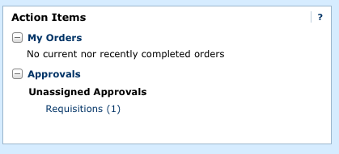
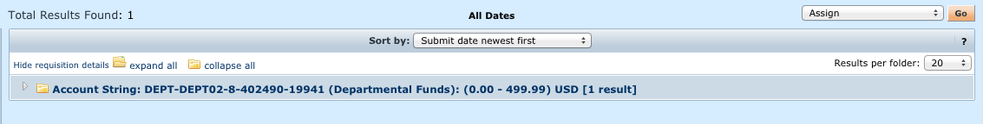
Approving from Gateway
1.
2.
Notes:
ok

Slide 26
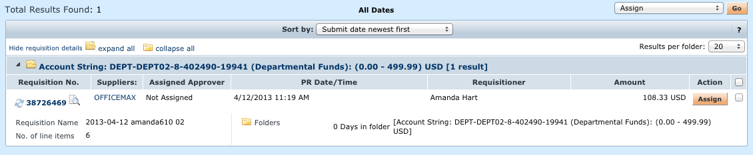
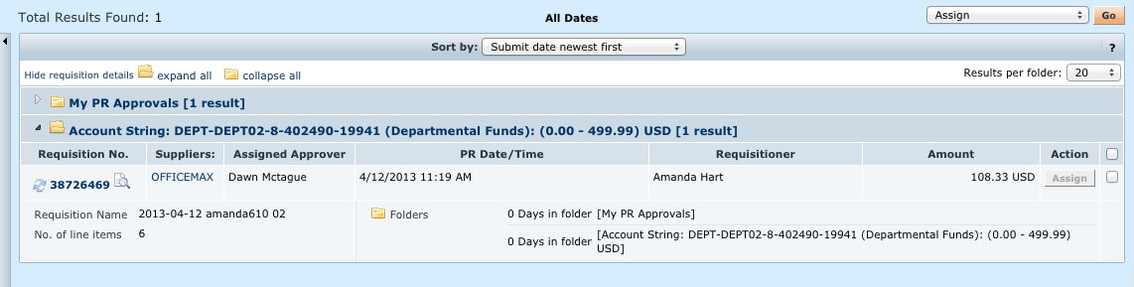
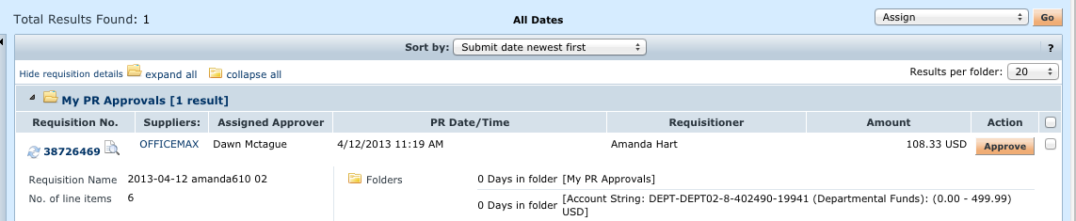
3.
4.
5.
Notes:
ok

